Slide 1

Sprint 1
The PK PALS

Slide 2
WEB DESIGNERS
Logos
layouts for your pages
Color Scheme ideas
Wesley Young
Sheeba Adli

Slide 3





WEB DESIGNERS - Logos
“homemade” logo from photoshop Two ai logos
Hollowed logos

Slide 4
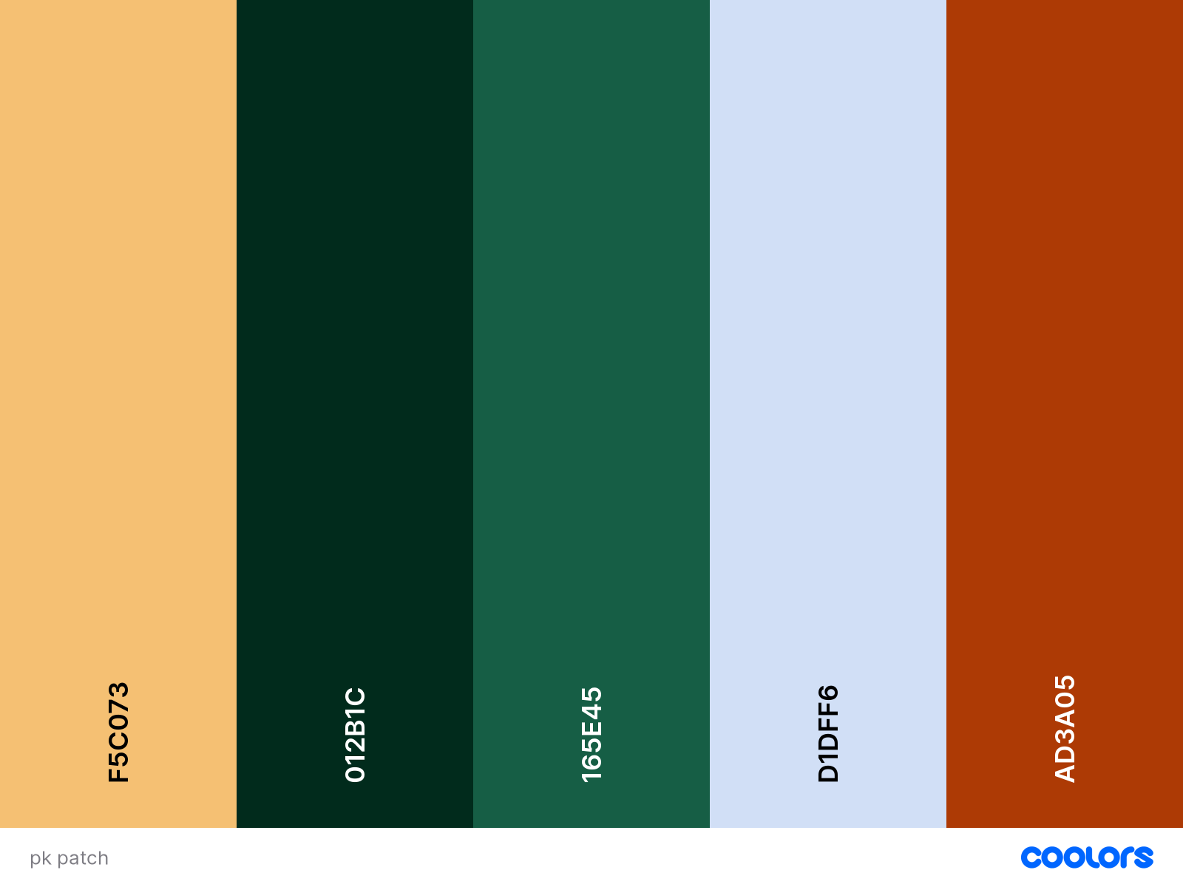
WEB DESIGNERS
Current Color scheme

Slide 5



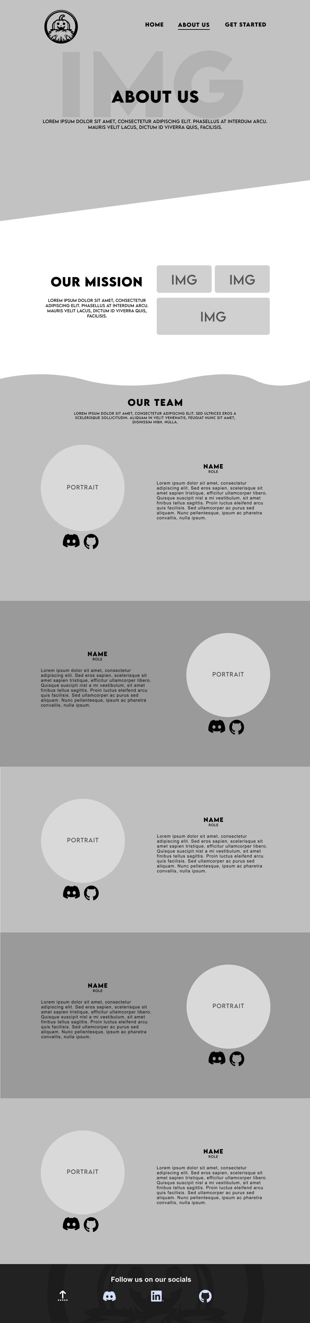
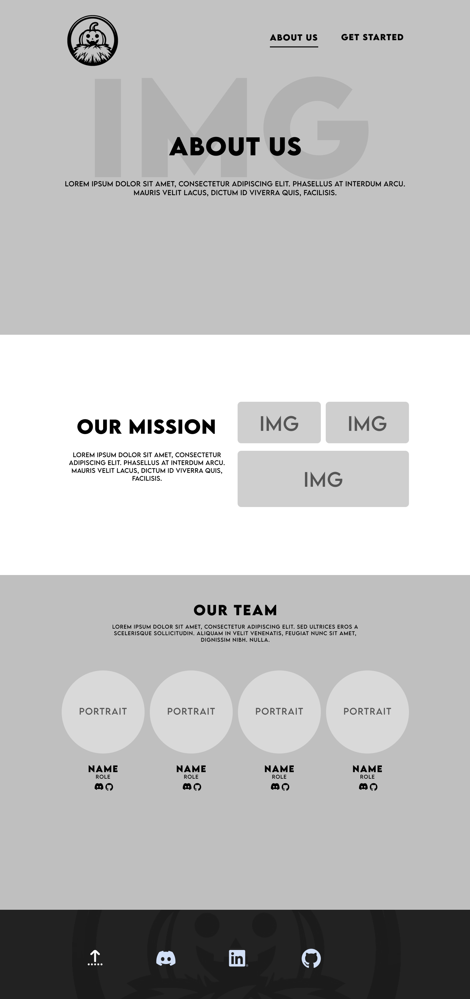
WEB DESIGNERS
Layouts
Home page layout
Home page 2 layout
About us page layout
About us page 2 layout

Slide 6
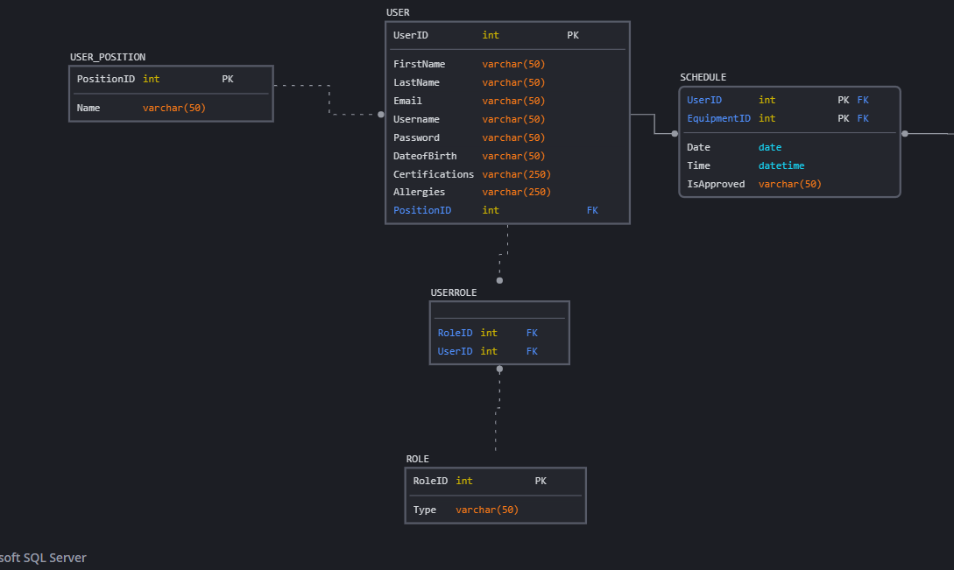
WEB DEVELOPERS
Logistics of ERD
Our project is tracking crop information for large-scale farms.
The plot table is a bridge table between the farm table and crop table. It will allow us to track which crops are in which plots and the history of each plot. Farms rotate different crops that soak up different nutrients so the user can store their plot’s history.
The crop table stores various information about the plants on the farm.
The farm table stores information about the farm’s Name, Size, and Location.
We have a Customer Table and Customer Roster that will hold cell phone numbers and emails of the customers of a specific farm. This will allow the farmers to collect their customers' contact information and later contact them about their products.

Slide 7
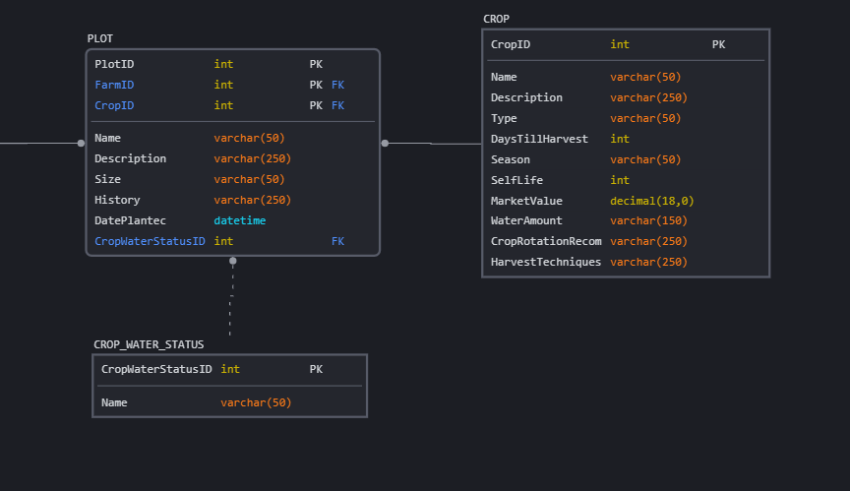
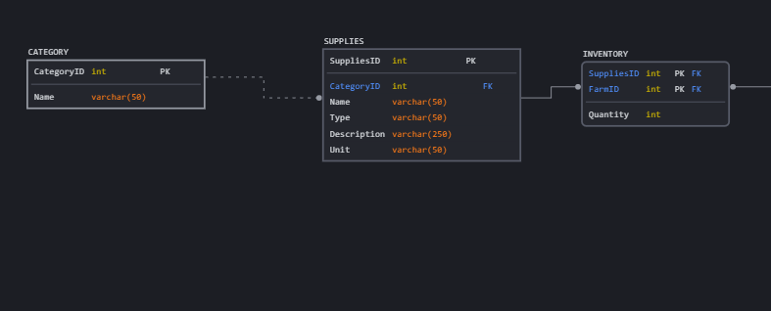
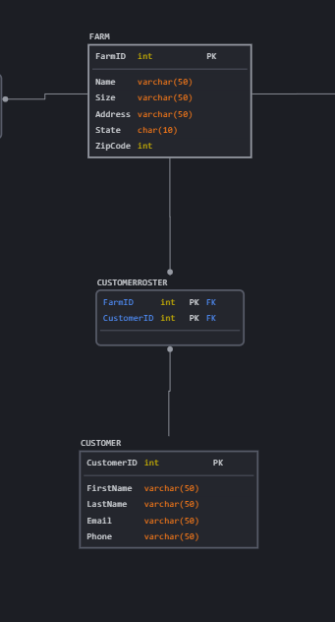
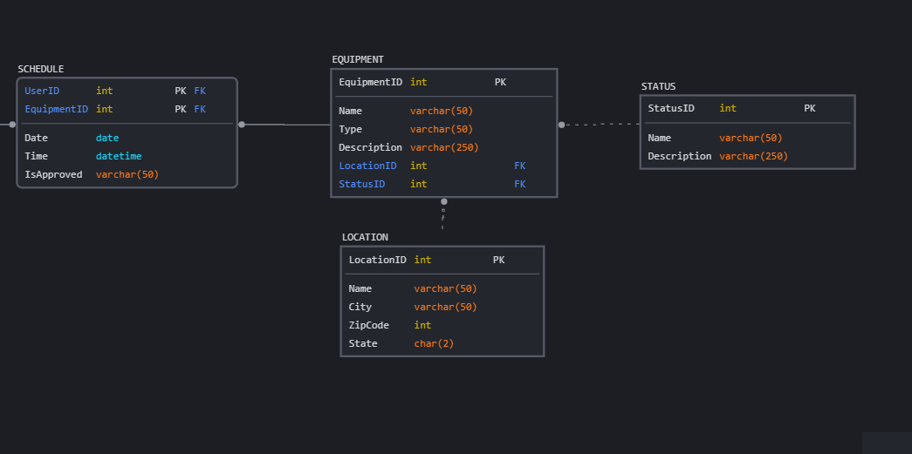
WEB DEVELOPERS
The Supplies table stores information about farming supplies such as fertilizer and seeds. The category table will help organize the supplies and the inventory table will show what supplies are specific to each farm.
Employee information will be stored in the User table and users will have roles given to them that will determine how much access they will have. (For example, Admin vs user)
The Equipment table will store information, including the location and availability (Status) of the equipment on the farm. Users will be able to make requests (Schedule Table) to use equipment that will be approved by a user with admin access.

Slide 8


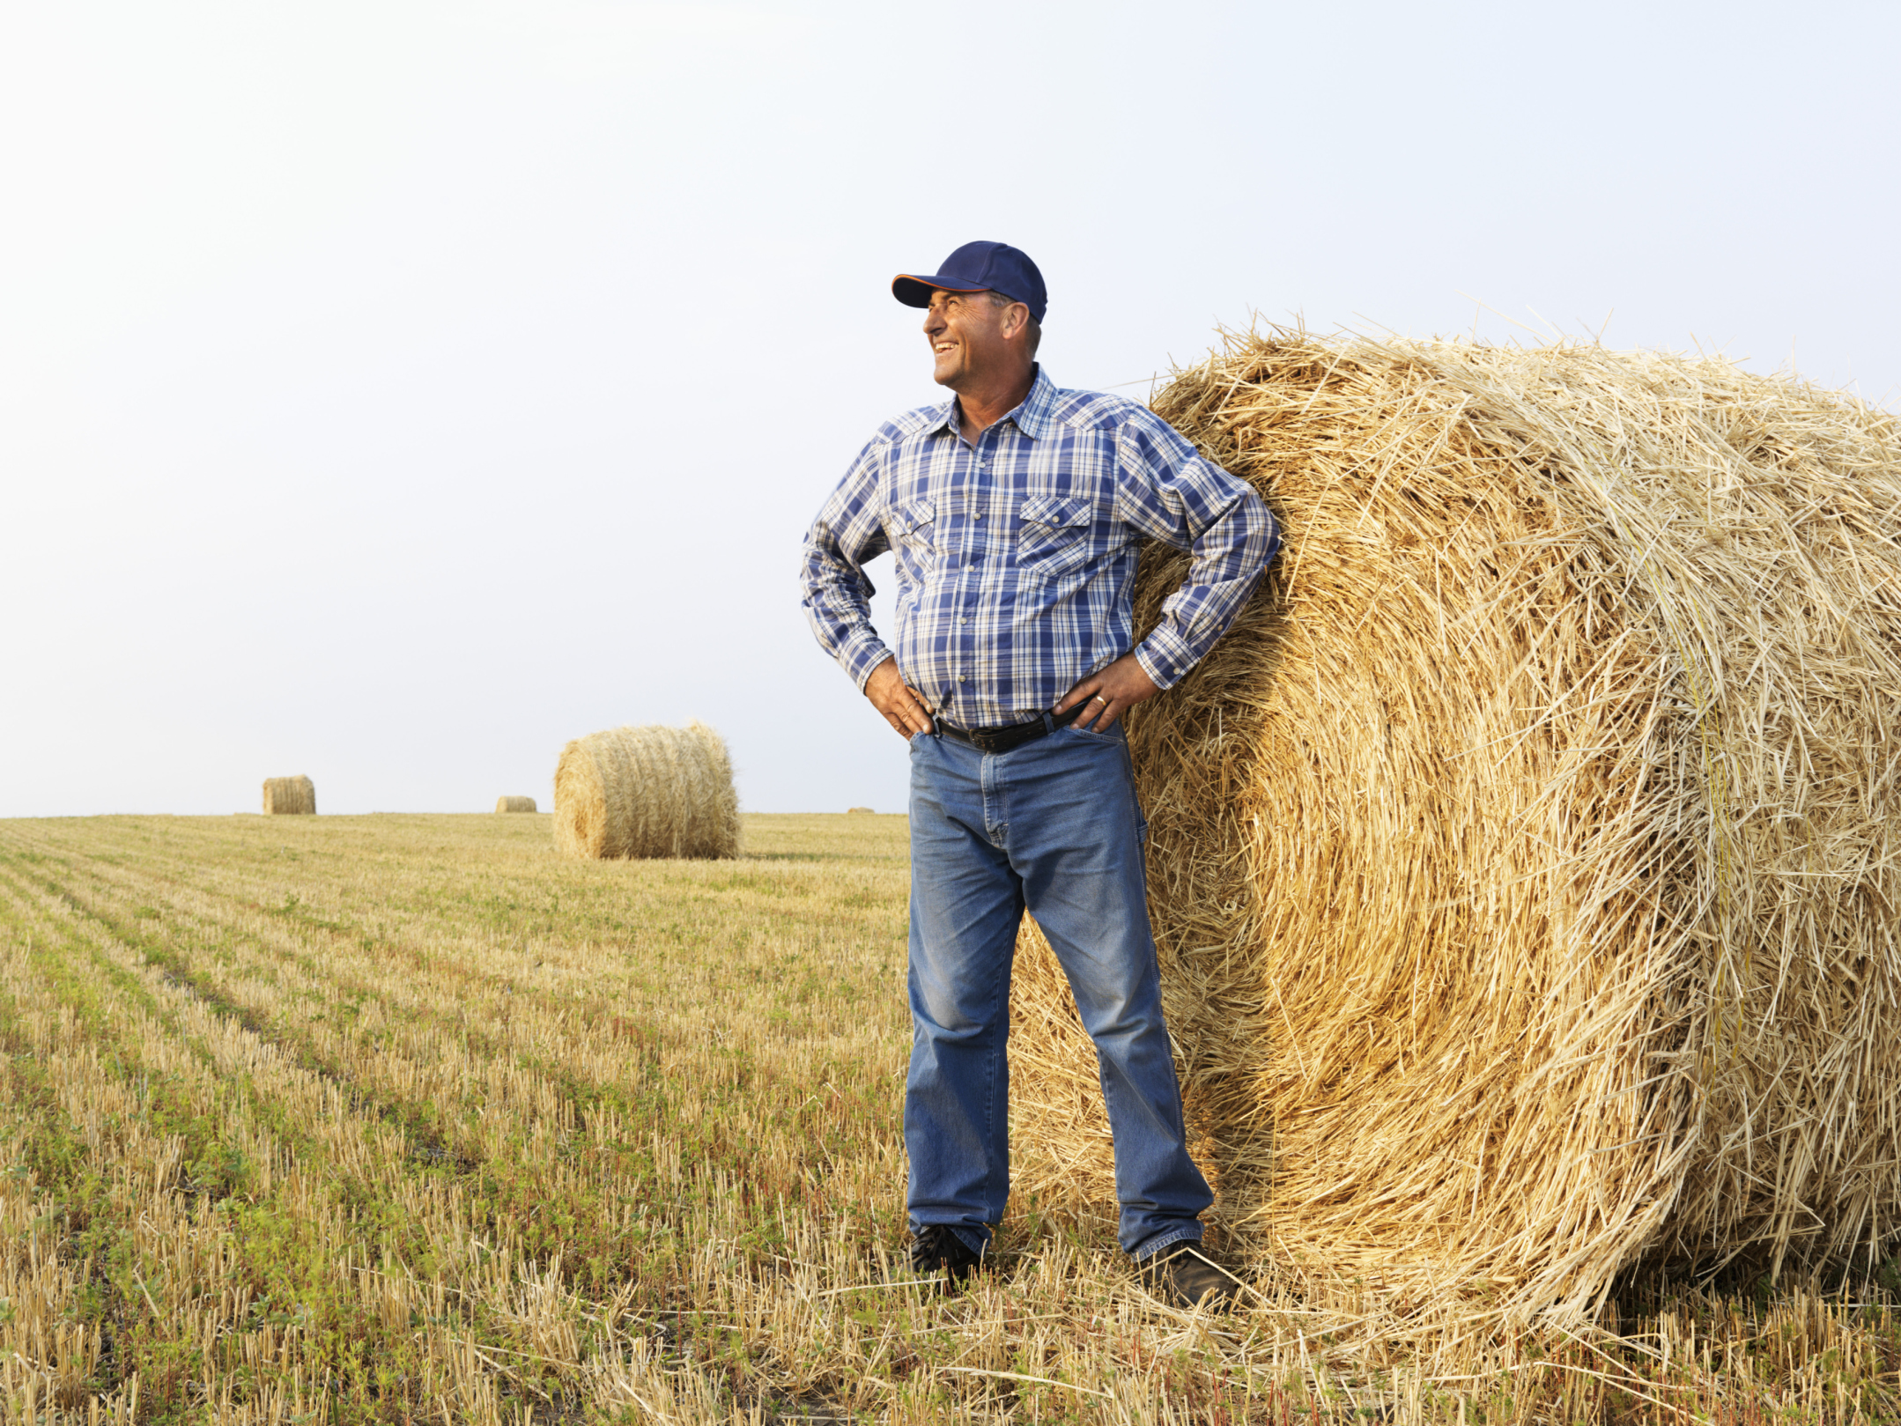
Micro apps - Brochure
Communicated with the team
Hex numbers
Completed out line
Included graphic's
DECIDED ON TEAM COLORS
Recorded information about out application
Created the Brochure
Made sure to include the same pictures we used on our site

Slide 9



Slide 10
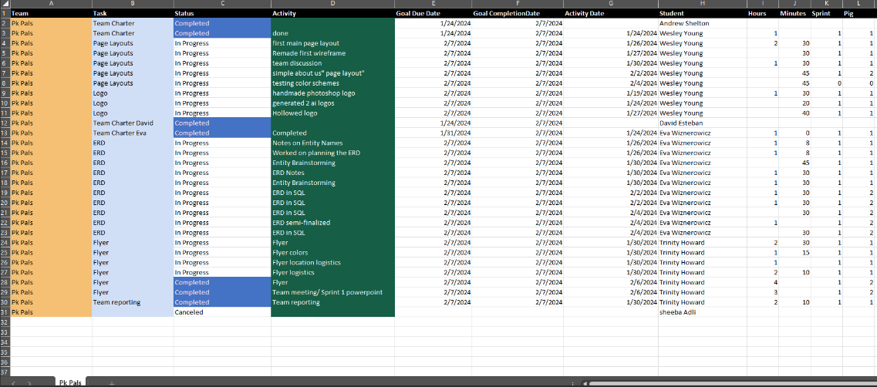
Micro apps – Team reporting

Slide 11

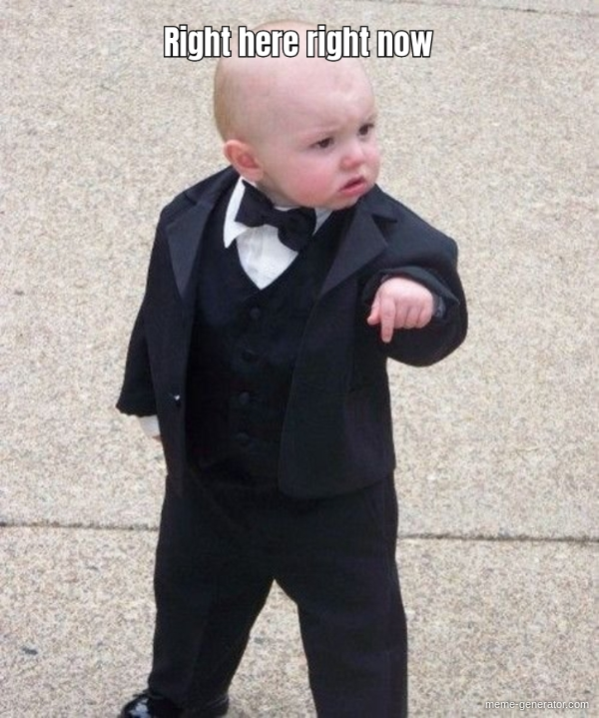


Micro apps- power point for Sprint 1

Slide 12
THANK YOU

